Slide 1
3.5 Recursion
ITP3914 – Programming
Part 3 – Basic Program Structures

Slide 2
Java Method Stack
A running Java program has a private stack called Java method stack, which is used to keep track of local variables and other important information on methods.
Each time a method is called, a frame is pushed on to the stack.
A frame keeps:
Method parameters
Local variables
Return point (RP) when the method completes.

Slide 3
public class Test {
public static void main(String [ ] args) {
int i=5;
...
cool(i);
...
}
public void cool(int j) {
int k=7;
...
fool(k);
...
}
public void fool(int m) {
...
}
}
1200
fool():
RP = 2300
m = 7
cool():
RP = 1200
j = 5
k = 7
2300
main():
RP = n/a
i = 5
Frame

Slide 4

You should now understand why:
A local variable (declared inside a method) is created when the method is being called.
A local variable is destroyed when the method terminates.

Slide 5
Recursion
A recursive method calls itself repeatedly.
Recursion is a natural way to solve some problems.
A recursive method divides a problem into two pieces:
A simple base case that the method can solve directly.
Another piece that resembles the original problem, but slightly simpler than the original problem.
A recursive method normally includes a return condition to avoid infinitely recurring into deeper and deeper levels.

Slide 6
CountDown
public class CountDown {
}
public static void main(String [ ] args) {
countDown(4);
System.out.println("Go! ");
}
C:\> java CountDown
5
4
3
2
1
Go!
public static void countDown(int n) {
System.out.println(n);
if (n > 1)
countDown(n-1);
}

Slide 7
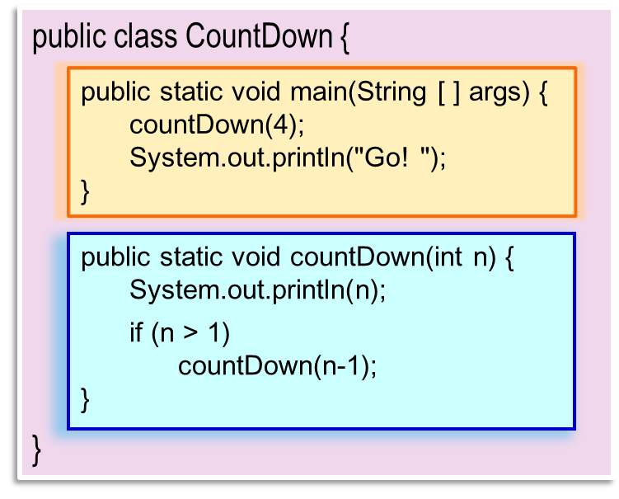
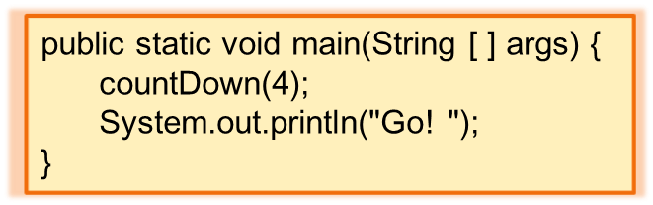
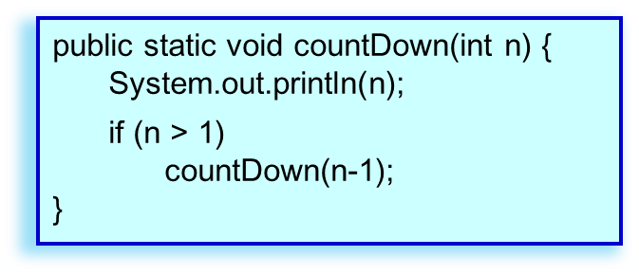
C:\> java CountDown
4
3
2
1
Go!
main():
4
countDown():
n = 4
C:\> java CountDown
4
3
countDown():
n = 3
C:\> java CountDown
4
3
2
countDown():
n = 2
C:\> java CountDown
4
3
2
1
countDown():
n = 1
C:\> java CountDown
4
3
2
1

Slide 8
Factorial
public class Factorial {
}
public static void main(String [ ] args) {
System.out.println( factorial(5) );
}
public static long factorial(int n) {
long ans;
if (n == 1)
ans = 1;
else
ans = n * factorial(n-1);
return ans;
}
24
5! =
5 x
4!
6
4! =
4 x
3!
2
3! =
3 x
2!
1
2! =
2 x
1!
return condition
1! = 1

Slide 9
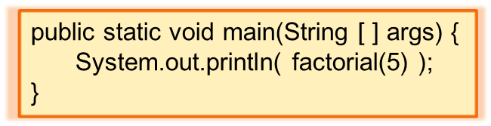
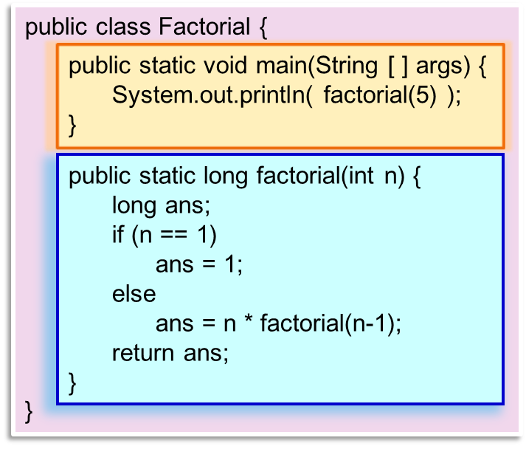
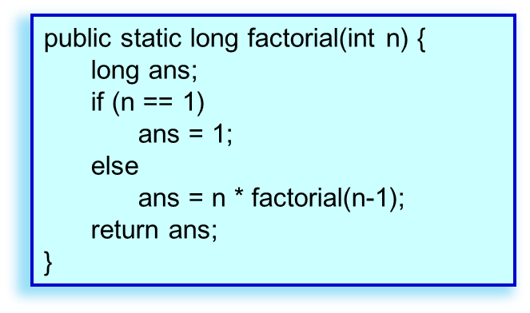
main():
5
factorial():
n = 5
ans = 5 * 24;
return 120;
4
factorial():
n = 4
ans = 4 * 6;
return 24;
3
factorial():
n = 3
C:\> java Factorial
120
ans = 3 * 2;
return 6;
2
factorial():
n = 2
ans = 2 * 1;
return 2;
1
factorial():
n = 1
ans = 1;
return 1;

Slide 10
Example – Fibonacci Series
The Fibonacci series:
0, 1, 1, 2, 3, 5, 8, 13, 21, …
begins with 0 and 1 and has the property that each subsequent Fibonacci number is the sum of the previous two Fibonacci numbers.
The Fibonacci series may be defined recursively as:
fibonacci(0) = 0
fibonacci(1) = 1
fibonacci(n) = fibonacci(n-1) + fibonacci(n-2)

Slide 11
f(6)
public class Fibonacci {
public static void main(String [ ] args) {
long f;
f = fibonacci(6);
System.out.println("Fibonacci(6) = " + f);
}
public static long fibonacci (int n) {
if (n==0 || n==1)
return n;
else
return fibonacci(n-1) + fibonacci(n-2) ;
}
}
f(5)
+
f(4)
...
f(3)
+
f(2)
...
f(2)
+
f(1)
...
f(1)
+
f(0)

Slide 12

Tower of Hanoi
Rod A
Rod B
Buffer
Mission: Move the n discs in rod A to rod B.
Rule: A larger disc must not be on top of a smaller disc.
Tool: A buffer rod is provided for temporary storage.

Slide 13
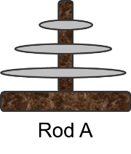
Exercise
Can you suggest a recursive solution to the Tower of Hanoi?

Slide 14

END.

